Slide 1
Investigating Force, Motion, and Energy
By: Mrs. Stone

Slide 2
Objectives
3.6 Force, motion, and energy. The student knows that forces cause change and that energy exists in many forms.
3.6(A) Explore different forms of energy, including mechanical, light, sound, and heat/thermal in everyday life.
3.6(B) Demonstrate and observe how position and motion can be changed by pushing and pulling objects to show work being done such as swings, balls, pulleys, and wagons.

Slide 3
Key Understandings
What is energy?
What are some forms of energy?
How is energy important in everyday life?
Energy exists in many forms.

Slide 4
Key Understandings
What is a force?
What does it mean to push something? Pull something?
What are some examples of pushing? Pulling?
In what ways can force affect the motion of an object?
Forces (pushes and pulls) cause change in the position or direction of motion of an object.

Slide 5
Key Understandings
How does gravity affect the motion of an object?
How does magnetic force affect the motion of an object?
Some forces are not directly observable. They can be measured by their effect on objects.

Slide 6
Misconceptions
Students may think energy is only in living things (humans and animals).
Students may think we do not need light in order to see, since we can see a little in a dark room.
Students may think the location of an object can be described by stating its distance from a given point, ignoring direction.
Students may think that if an object is at rest, no forces are acting on the object.
Students may think mass and weight are the same thing.

Slide 7
Energy
The ability to make things happen (anything that has the potential to create change or do work).

Slide 8
Force
A push or pull that changes the position or motion of an object/material.

Slide 9
Gravity
The force that pulls objects toward each other; gravity causes objects to fall toward the center of the Earth.

Slide 10
Friction
A force that slows objects down.

Slide 11
Magnetism
A force that pulls magnetic materials across a distance.

Slide 12
Mechanical Energy
The energy of moving things.
2 types:
Potential Energy
Kinetic Energy

Slide 13
Puff Cup Contest
Students will work in groups of 3-4 to see which group can move their cup the greatest distance in 15 seconds.
Did you move the cup by pushing or pulling?
What is the difference between pushing and pulling?
What provided the force or push to move the cup?
Record your activity in your science journal.

Slide 14
Force (Push and Pull): Puff Cup Contest Instructions
Place your cup right in front of the starting line on your group’s table (or on the floor).
You are to use only the plastic bottle to move the cup as far as possible down the table (or floor).
You may not touch the cup or the bottle to touch the cup.
You will have 15 seconds to move your cup as far as possible.
At the end of 15 seconds, I will say stop. You must put your bottles down and wait for the next set of instructions.
Take a few minutes to discuss your plan of action and practice using the bottle to move the cup. Remember you cannot touch the cup with the bottle.
Select one person to be in charge of moving the cup with the bottle. The rest of you will be coaches and cheerleaders.

Slide 15
ScienceSaurus pg. 280-285

Slide 16
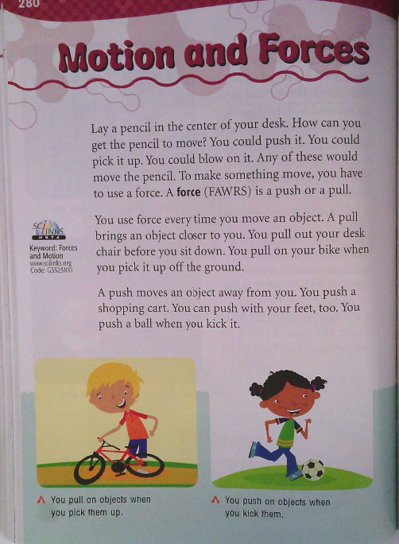

Slide 17
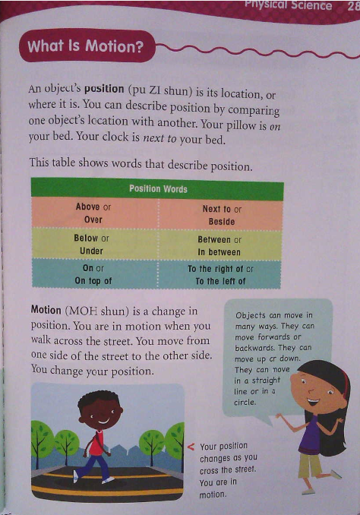

Slide 18
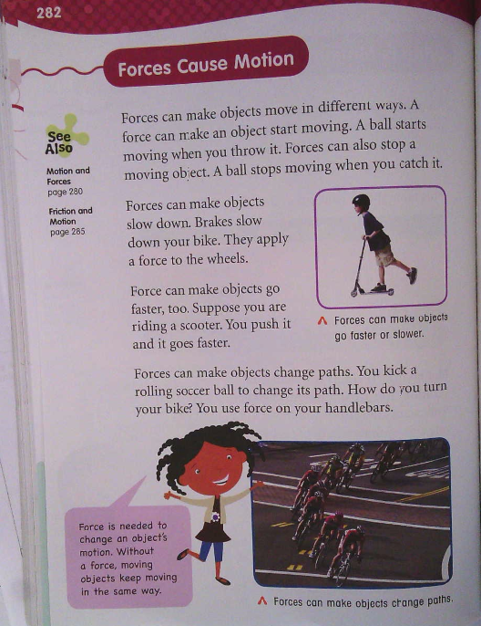

Slide 19
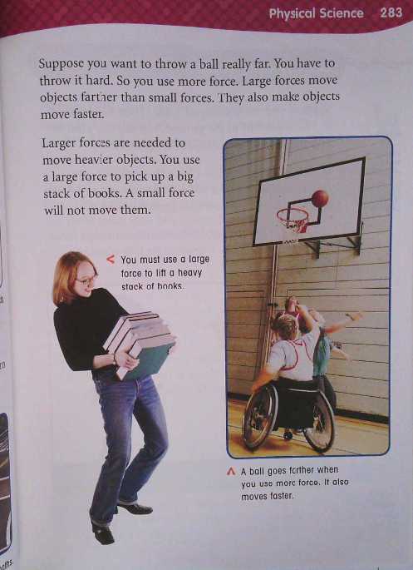

Slide 20
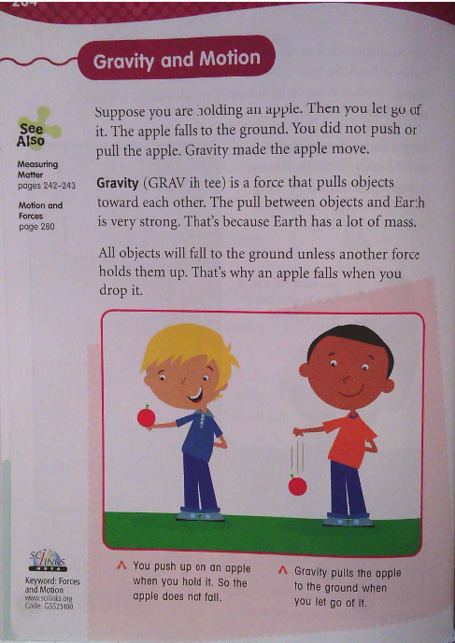

Slide 21
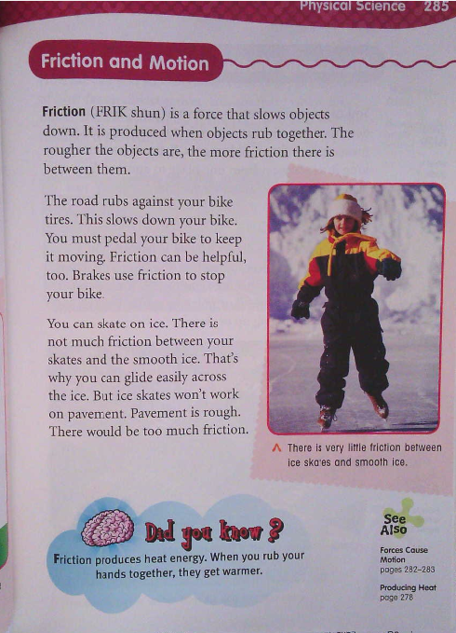

Slide 22
Gravity
The force that pulls objects toward each other; gravity causes objects to fall toward the center of the Earth.

Slide 23
Gravity Experiment
Place the toy car on a long table or on the floor, marking its current resting position with a piece of masking tape.
What is the car doing right now?
Science Spiral: illustrate a car at rest

Slide 24
Gravity Experiment Continued
When an object is not moving, we say it is “at rest”.
An object at rest, like this toy car, will not move unless a force is applied to it.
How could you make this car move?

Slide 25
Illustrate the following in your Science Journal
A car at rest
A car that has been pushed with a weak force.
A car that has been pushed with a strong force.
A car that has been pulled.
Use an arrow to show the direction of movement and the change in position of the car. Discuss how friction helps/hinders the car's movement.
Friction: A force that slows objects down.

Slide 26
Journal Write
An object “at rest” is not moving; it is still.
A force (push or pull) can make an object start to move when it is “at rest”.
A force can also cause objects to stop.
Some forces are stronger than others, and forces have direction.

Slide 27
Magic School Bus Plays Ball

Slide 28
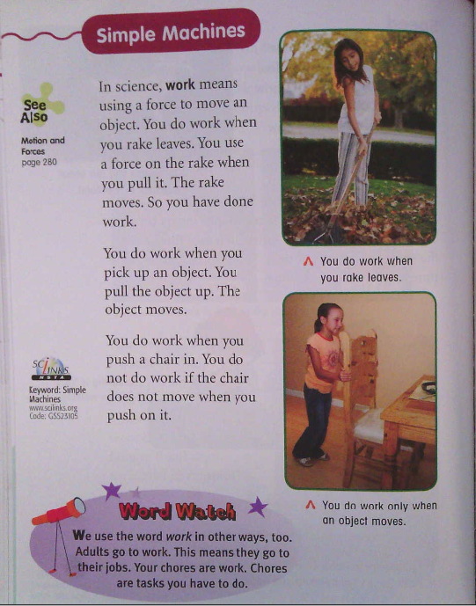
Work

Slide 29
Forms of Energy

Slide 30
Two Forms of Energy
Heat and light are two forms of energy that cause change.
Heat Energy
Light Energy

Slide 31
Brainstorm examples of other forms of energy such as sound, electrical, mechanical.

Slide 32
Discovery Education: Forms of Energy
Pshare>elementary>science>energy>Forms of Energy
22:21 minutes

Slide 33
Science Journal
Write three complete sentences in your science journal about the forms of energy you have learned about.

Slide 34
All Four Forms of Energy
Sound
Mechanical
Light
Thermal
(heat)

Slide 35
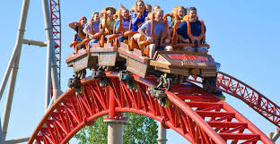
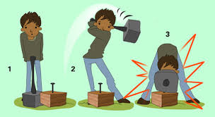
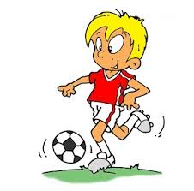
Mechanical Energy
Energy of motion

Slide 36
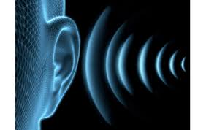
Sound Energy
Energy you can hear; energy made when matter vibrates

Slide 37
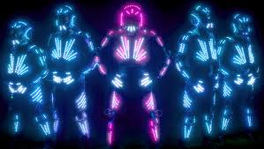
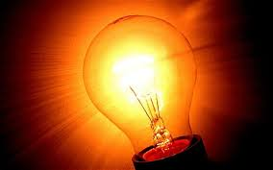
Light Energy
Energy that you can see

Slide 38
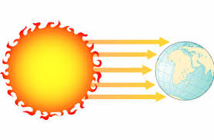
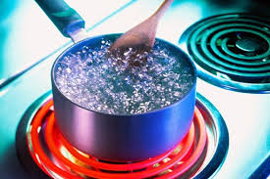
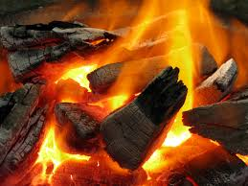
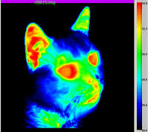
Thermal Energy (Heat Energy)
The energy of moving particles

